Slide 1



For Families
Notes:
Prior to the session, review the notes and mark pages and lines in your copy of the ALA to assist parents as you review important pieces of the ALA in this presentation.
This is a tightly packed session. You may want to consider creating a parking lot for questions – have parents write their questions during the presentation on sticky notes and stick to the parking lot (sticky chart page) on their way out. You can then address the questions in follow up emails or future grade level meetings.
SAY: Welcome to this session about the Alabama Literacy Act. Thank you for being here to support your child.
HANDOUTS FOR PRESENTATION:
Handout 1 Print Slide 2 with QR code to place around the room. ALAFamily&CommunityEngagement_QR Code.docx
Handout 2 Sign In Sheet (QR Code will be shared)
Handout 3 Slide 6: Family & Community Support QR Codes QR Codes Flyers
Handout 4 Slide 17: Alabama Literacy ACT_FAQ_August2023.pdf
Handout 5 Slide 18: My Child Can Packets Handout 23-24 My Child Can! Booklets
Handout 3 (Again) Slide 18: Family & Community Support QR Codes QR Codes Flyers

Slide 2
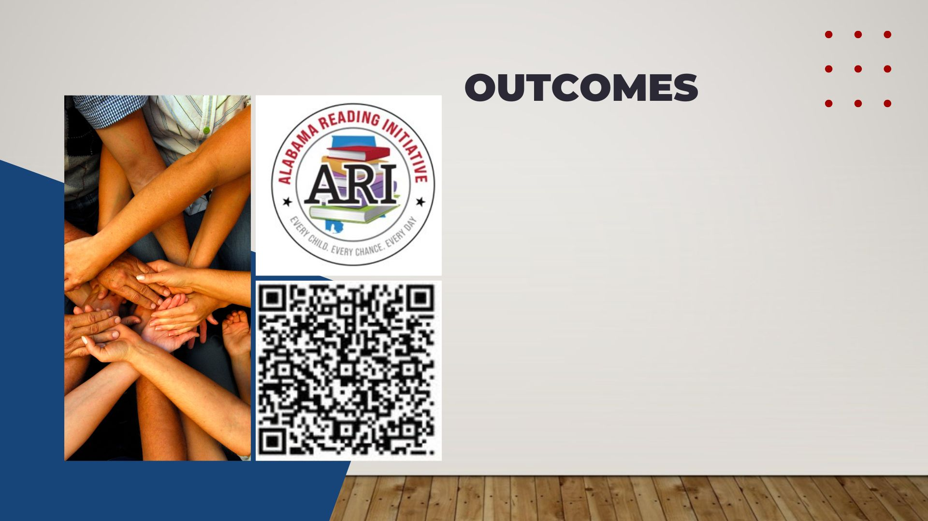
Participants will:​
Develop an initial understanding of the Alabama Literacy Act and its impact on classroom instruction and students’ growth/achievement.​
Set goals for at-home literacy support.
Region 10
Notes:
4 min.
Handout 1 & 2
Have participants sign in with the QR Code on the slide but also use (Handout 2:a school created sign in sheet) just in case there are technical difficulties.
New Sign-in link
https://forms.office.com/r/6AGFs0CjmU
Be sure to provide support with completing the sign-in. Families will be asked to identify their region. We want to be sure this information is accurate.
Have participants read the outcomes.
Say: I hope that today you leave with:
an initial understanding of the ALA,
ways to support your students’ growth and achievement,
Activities you can use at home to promote literacy.
If parents are unable to sign in due to internet issues, the LRS will need to submit the parent information to the QR code after the session.

Slide 3
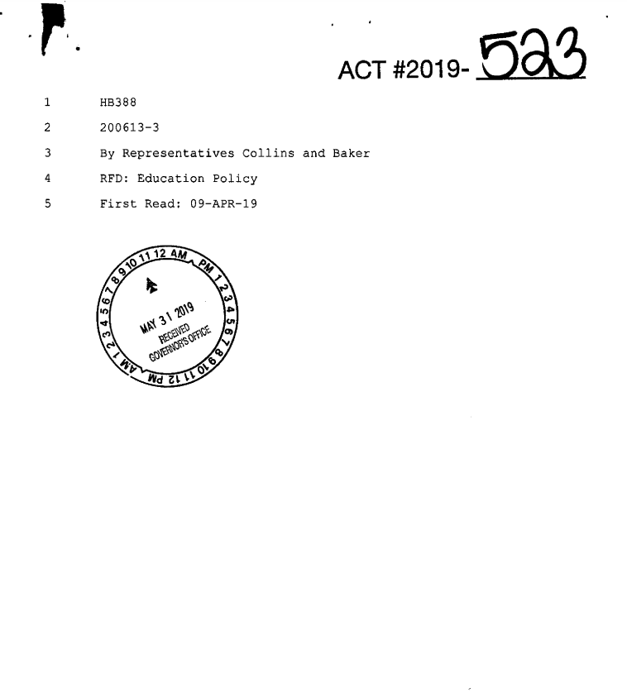
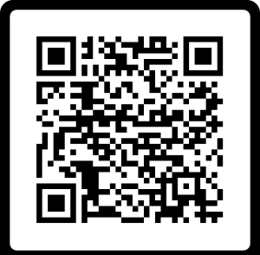
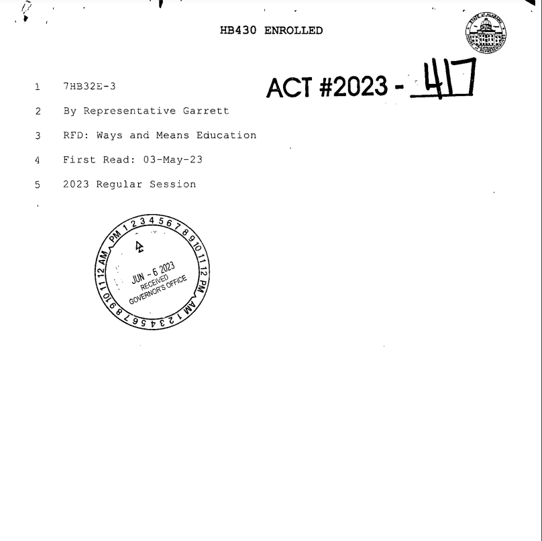
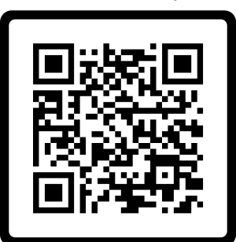
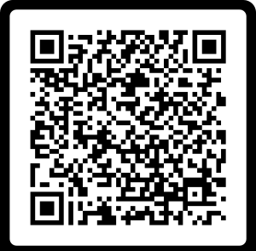
WHAT IS THE ALABAMA LITERACY ACT?
Purpose:
To implement steps to improve the reading proficiency of public-school kindergarten to third grade students and ensure that those students are able to read at or above grade level by the end of the third grade by monitoring the progression of each student from one grade to another, in part, by his or her proficiency in reading.
(Page 1, Lines 4-9)
2022 Updates:
Notes:
1 min.
Say: The purpose of the ALA is to ensure that all students are proficient readers by the end of 3rd grade.
This is a picture of the actual ALA. We want students reading at or above grade level by the time they exit 3rd grade. We do this by monitoring their progress in reading proficiency from grade level to grade level.

Slide 4

CURRICULUM & STANDARDS
2021 ELA COS supports essential learning to improve reading proficiency in accordance to the ALA.
Standards focus on foundational skills needed to support literacy development.
Development of the standards was guided by the science of reading.
Standards that define the minimum content of what learners should know and be able to accomplish at each grade level.
Notes:
1-2 min.
Read parent friendly bullets
Bullet 2 - Read the parent friendly definition of the Science of Reading:
The science of reading is a body of research from thousands of studies which have revealed how we learn to read, what goes wrong when students don't learn, and what kind of instruction is most likely to work the best for most students. (Moats, 2020 & Reading League).

Slide 5

Every child. Every chance. Every day.
Scientifically-Based reading instruction and multisensory language instruction in the following areas:​
Oral language development ​
Phonological awareness​
Phonics ​
Fluency​
Writing​
Vocabulary​
Comprehension​
Alabama Course of Study
Notes:
1 min.
On this slide, we have information about the different parts of tier one instruction, which is the main reading instruction for all students.
You'll see the scientifically proven instructional components. These are the essential elements that are backed by research and help students learn effectively.
The tier one reading block includes both whole group instruction, where the entire class learns together, and small group instruction, where students receive personalized support based on their individual needs.
It's important to note that all students get opportunities to practice what they've learned through connected activities. This ensures that every student can apply and reinforce their reading skills.
Every child. Every chance. Every day.

Slide 6

INTERVENTION REQUIREMENTS
  Additional instructional time spent on proven methods of reading instruction and intervention
  Daily small group reading intervention that focuses on what the student needs
  Frequent monitoring of the progress of the reading skills of each student throughout the school year and adjusting instruction according to student need
Notes:
5 min.
Handout 3 Family & Community Support QR Codes QR Codes Flyers
SAY:
One way we can meet these intervention requirements is through Tier 2 instruction. If, for example, you have students with multiple areas of deficiency, teachers will provide targeted instruction on a specific deficiency during Tier 2. This is a great way to bring in additional multisensory strategies. Reference your Parent Resource handout for activities that can be used at home as you practice foundational reading skills with
FACILITATORS: Here are some examples that could be used for multisensory instruction if needed.
Multisensory Strategies:
Letter Naming Fluency deficiency – work with alphabet arcs.
LWSF deficiency – if need is accuracy: work with letter/sound correspondence (tactile experiences such as sand trays/fingerpaints/etc. child writes letter as he/she says sound aloud) If need is automaticity: work with RAN activities (letter names, sounds, objects, numbers – focus here is on strengthening the processing speed from print to speech)
NWF deficiency – work with blending (blending boards, blending lines, analytic phonics (word families), etc.) NOTE: Reading nonsense words is not a SKILL. It is an INDICATOR of student blending ability. Simply drilling nonsense words will not correct the foundational issue and is not a best practice for instruction.)
WRF deficiency – if accuracy: work with strategies for decoding nonphonetic patterns, such as heart word strategies, explicit phonics instruction, phoneme-grapheme mapping, etc. If fluency: practice with RAN activities using high frequency words)
ORF deficiency – if accuracy: explicit phonics instruction w/ additional multisensory elements. If fluency: explicit fluency instruction (phrasing, expression, prosody, etc.)
Vocab deficiency – Vocabulary preloading for upcoming lesson, semantic mapping activities, LETRS vocabulary strategies
Comprehension deficiency – Explicit comprehension skill lesson, oral language building activities (read alouds / graphic organizers / writing activities)
Please note these are not the only activities that can be used, but they can help give you some ideas of ways to meet these specific deficiency areas.

Slide 7
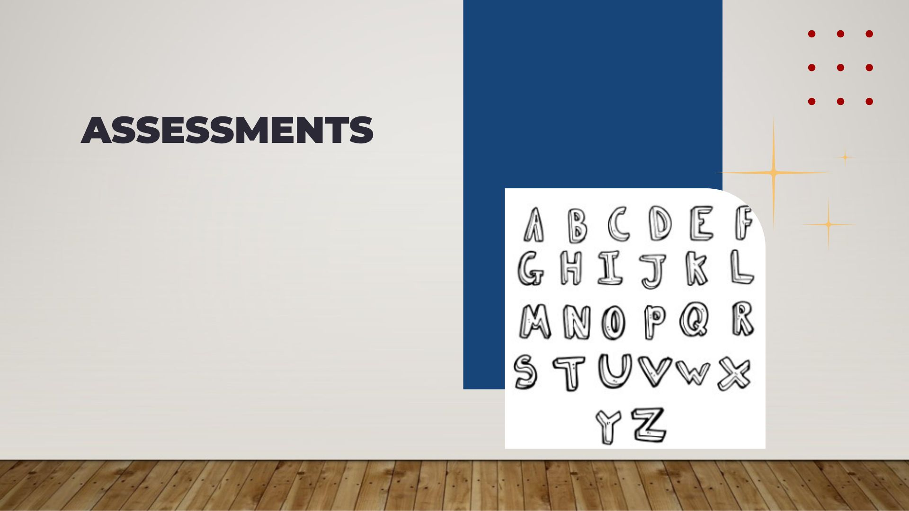
Screening and diagnostic information for monitoring student progress
Measure phonological awareness (hearing the sounds), the alphabetic principle (letter/sound knowledge), decoding (letter/word recognition), encoding (spelling), accuracy, vocabulary, and comprehension
Help to identify students who have a reading deficiency, including identifying students with characteristics of dyslexia
Notes:
2 minutes
Say: The ALA includes information specifically pertaining to assessing literacy. Students are screened, at a minimum, 3 times a year. (Beginning of the year, middle of the year, and end of the year). The screening data guides the instruction in the classroom.
Read bullets at the top.
Schools have selected an early literacy assessment that meets the requirements on this slide.

Slide 8

SRIP (Student Reading Improvement Plan)
A guide for instruction for the student based on the specific deficiency in reading
Developed for the student by teachers and others in the school, along with parent input, within 30 days of the identification of deficit
Parents are notified monthly of progress
Intervention instruction is evidence-based reading intervention
The student will receive intense intervention until the student no longer has a deficiency in reading
SRIP
Notes:
5 min.
Read the bullets as they fly in.

Slide 9





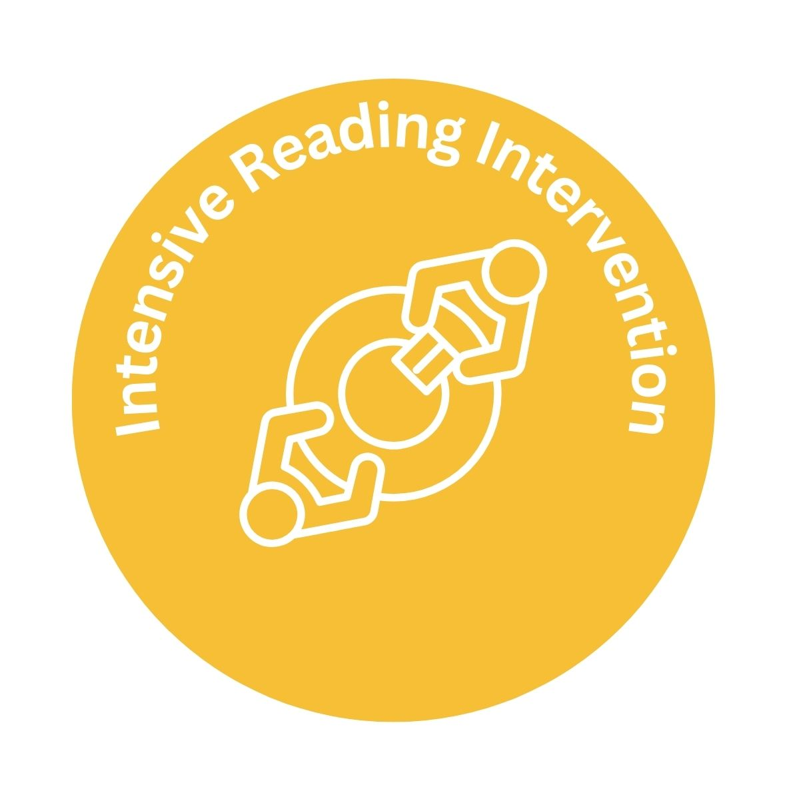
Layers of
Support
Notes:
2 minutes
Say: These are the layers of support for a student with reading deficiencies according to the ALA - if multiple pieces of data support a consistent reading deficiency for a child, then the school notifies the parents/guardians of the identification and begins intervention supports in an effort to remedy the reading deficiency.
As a reminder, the retention provision of the law will begin during the 2023-2024 school year. The 2023-2024 3rd graders will be the first students impacted by the promotion/retention requirement.
Every child. Every chance. Every day.
Facilitator Note: Before & After school tutoring varies at each school. Some schools offer tutoring before school and some schools offer tutoring after schools.

Slide 10


SUMMER READING CAMPS
Alabama Summer Achievement Program is for all K-3 students in public elementary schools that are among the lowest performing five percent in reading
High quality summer reading camps at elementary schools that are not among the lowest five percent performing elementary schools
All K-3 students identified with a reading deficiency, or the characteristics of dyslexia
Notes:
2 min.
Say: In addition to in-school supports, schools are required to provide students who have an SRIP the opportunity to attend summer reading camp that includes 60 hours of scientifically-based reading instruction and intervention. Highly effective teachers will provide this instruction and use scientifically based instruction and interventions. Students progress will be measured before, during, and at the end of the summer reading camp.

Slide 11
SUMMER READING CAMPS
A minimum of 60 hours of scientifically based reading instruction & intervention
May be held in conjunction with existing summer programs, designated as effective by the State Superintendent
High quality instruction with assessments administered at the beginning and end of the summer camp to measure progress
Notes:
2 min.
Say: In addition to in-school supports, schools are required to provide students who have an SRIP the opportunity to attend summer reading camp that includes 60 hours of scientifically-based reading instruction and intervention. Highly effective teachers will provide this instruction and use scientifically based instruction and interventions. Students progress will be measured before, during, and at the end of the summer reading camp.

Slide 12

PROMOTION TO FOURTH GRADE
Third graders can be promoted to fourth grade by…
Scoring above the lowest achievement level on a State Board approved assessment in reading. (ACAP)
Earning an acceptable score on an alternative (supplemental) reading assessment.
Demonstrating mastery of essential third grade state reading standards. Evidence pieces will be collected and stored in a Literacy Act Portfolio for each third grade student.
Notes:
2 min.
Say: Students will have several opportunities to demonstrate reading proficiency in 3rd grade. For students to be promoted from third grade to fourth, one of three criteria must be met. (facilitator reads slide and explains in parent friendly terms.)
Here are the bullets in parent friendly terms:
Students will take a state assessment called ACAP in the spring. Students who score above the lowest achievement level on this assessment in reading will be promoted to fourth grade.
Students who attend summer reading camps will be given the ACAP supplemental assessment at the end of camp. Students who earn an acceptable score on this assessment will be promoted to fourth grade.
Students who demonstrate mastery of third grade essential reading standards through evidence collected in a reading portfolio, the Literacy Act Portfolio, will be promoted to fourth grade. The Literacy Act Portfolio evidence pieces are collected throughout the third grade year.
Additional Information for facilitators only:
This information is located on page 21, line 17 – page 22 line 9.
“Scoring above the lowest achievement level” refers to meeting the cut score for reading sufficiency (not proficiency) on the ACAP, which is the “State Board approved assessment in reading.”
“Earning an acceptable score on an alternative reading assessment refers to the ACAP supplemental that is given at the end of summer reading camp.

Slide 13
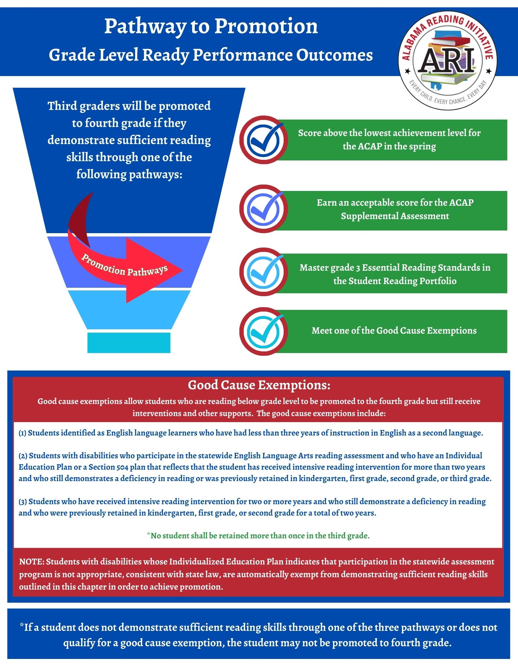
GOOD CAUSE EXEMPTIONS
Students identified as English language learners who have had less than three years of instruction in English as a second language. ​
Students with disabilities who have an Individualized Education Plan (IEP) or a section 504 plan that reflects that the student has received intensive reading intervention for more than two years or was previously retained in kindergarten, 1st, 2nd, or 3rd grade.​
Students who have received intensive reading intervention for two or more years and who still demonstrate a deficiency in reading who were previously retained in kindergarten, 1st, 2nd, or 3rd grade for a total of two years. ​
***No student shall be retained more than once in 3rd grade.​
Notes:
2 min.
Say:
What happens if a student does not demonstrate proficiency? For those students who do not meet one of the three pathways listed on the previous slide, here are the good cause exemptions for promotion to 4th grade per the ALA.
Students identified as English language learners who have had less than three years of instruction in English as a second language.
Students with disabilities and have an Individualized Education Plan (IEP) or a section 504 plan that reflects that the student has received intensive reading intervention for more than two years or was previously retained in kindergarten, 1st, 2nd, or 3rd grade.
Students who have received intensive reading intervention for two or more years and who still demonstrate a deficiency in reading who were previously retained in kindergarten, 1st, 2nd, or 3rd grade for a total of two years.
***No student shall be retained more than once in 3rd grade.
(Example: Sally repeated 1st grade. She can repeat 3rd grade. Johnny repeated 3rd grade last year. He will receive a good-cause exemption because no student can repeat 3rd more than one time.)
The school district’s superintendent makes the final call on issuing good cause exemptions based on the evidence submitted in the student’s Literacy Act Portfolio.

Slide 14

RISING 4TH GRADERS WITH GOOD CAUSE EXEMPTIONS
A student who is promoted to fourth grade with a good cause exemption shall continue to receive intensive reading intervention that includes specific reading strategies prescribed in the individual reading improvement plan of the student until the deficiency is improved.
Notes:
2 min.
Say: Students who are promoted to fourth grade through a good cause exemption will continue to receive targeted support in their area of reading deficiency.
Say: Examples of Continued Targeted Support:
Instruction with embedded research-based multisensory strategies
Multiple opportunities to practice identified skills
Daily targeted small group instruction
Intensive intervention based on the student needs

Slide 15
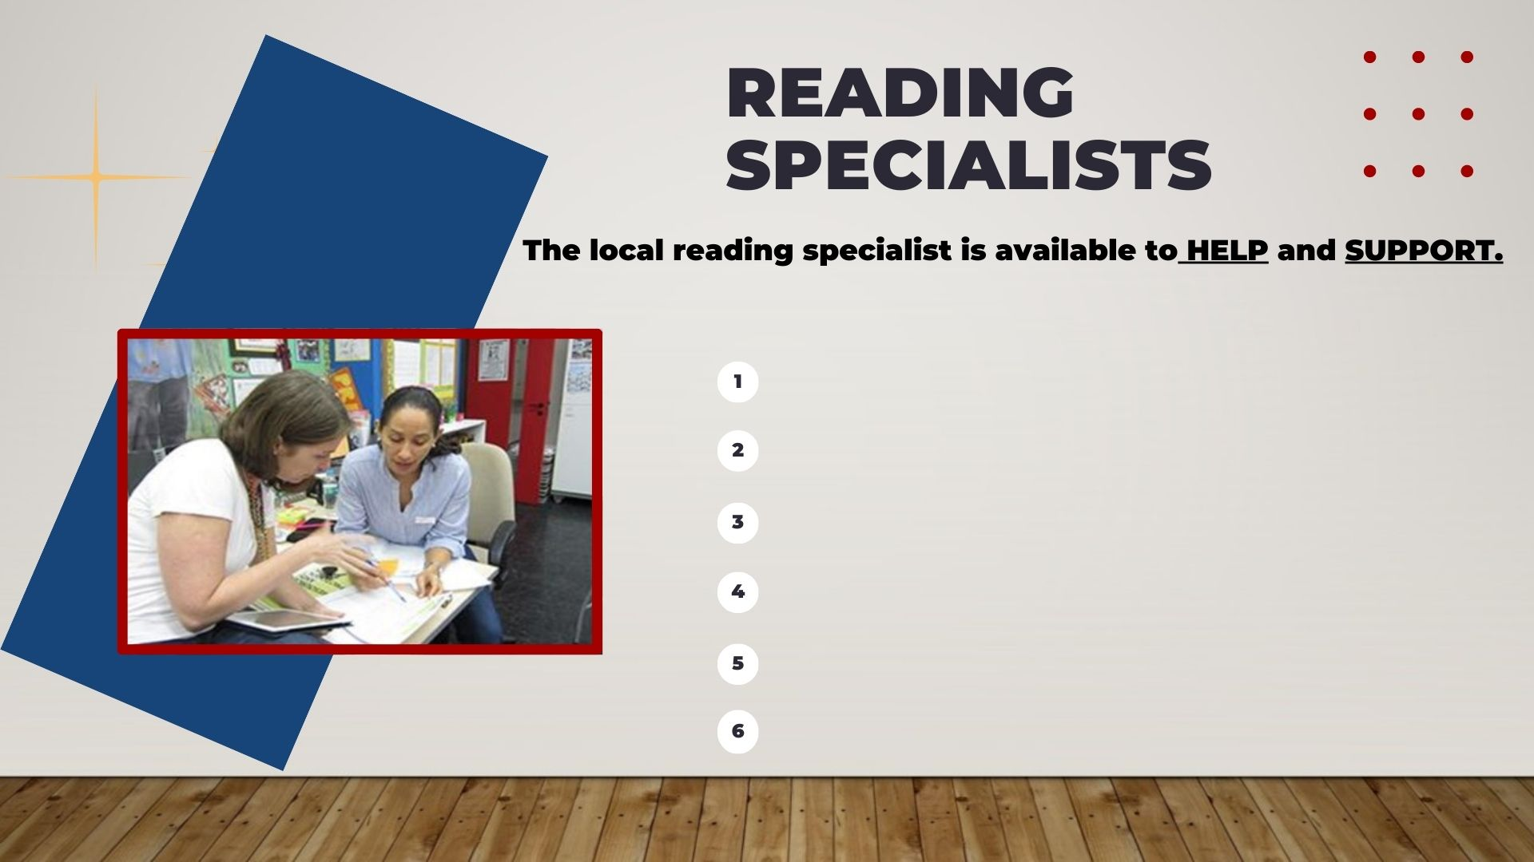
Model instructional strategies
Facilitate learning opportunities
Coach & mentor
Shares resources for community support
Monitors student progress
Analyze data
Notes:
2 min.
SAY: The local reading specialist at your school is available to HELP and SUPPORT teachers and student growth in your schools. They provide instructional tools and strategies to support teachers in their understanding of the science of reading and best instructional practices.

Slide 16


RETAINED THIRD GRADERS ​
How will schools help students who are retained in 3rd grade because the student does not meet the promotion requirement?
Students retained in 3rd grade will receive more intensive reading intervention services including:
Reading instruction provided by a highly effective teacher;
Dedicated time each day for intensive reading instruction;
Reading instruction that is grounded in the Science of Reading;
Frequent monitoring to help ensure students are progressing and on track to meet grade-level reading standards;
A Family Read-at-Home Plan.
Notes:
2 min.
Say: Students retained in 3rd grade should receive more intensive reading intervention services, including the 5 starred areas you see on this slide.
Facilitator reads the information on the slide.
Say: The ALSDE has created resources for parents. We will share how to access these resources later in the session

Slide 17
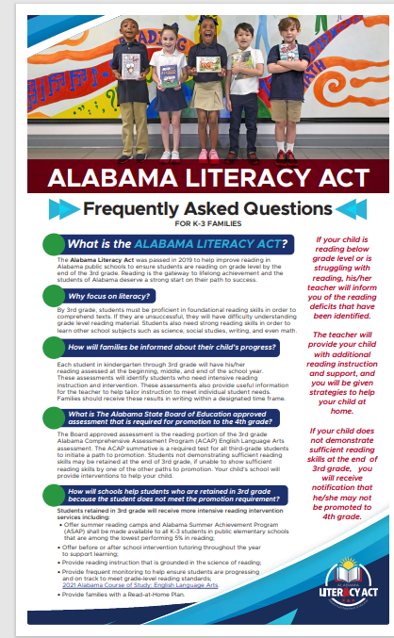
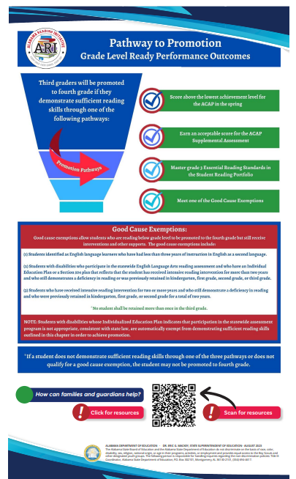
Frequently
Asked
Questions
Notes:
2 min. Handout 4 FAQ sheet for parents
Handout 4: Link to FAQ - Alabama Literacy ACT_FAQ_August2023.pdf
SAY:
This resource is a two page document that can help you, as a parent, with any questions you may have about the Alabama Literacy Act and how it affects your child’s education in the classroom. It discusses questions you may have, and what expectations are in the upcoming year according to the law. It also answers questions like…How you will be informed about your children’s progress, How schools will help students who are retained in 3rd grade because the students do not meet the promotion requirements, and resources on how you can help from home.
This resource was mailed to parents of all K-3 public school children in AL to provide them with information concerning the ALA. Notice it outlines:
what the ALA is, why we focus on literacy, what happens if their child is not reading at grade level, what are the considerations for promotion to fourth grade, how the school helps students who are struggling, and how parents can help at home.
Parents can scan the QR code to access additional resources.

Slide 18
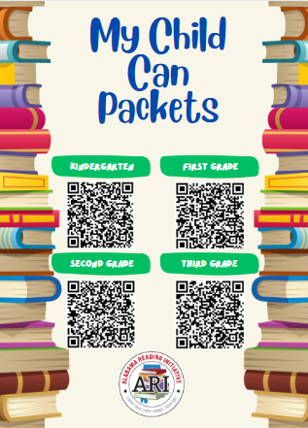
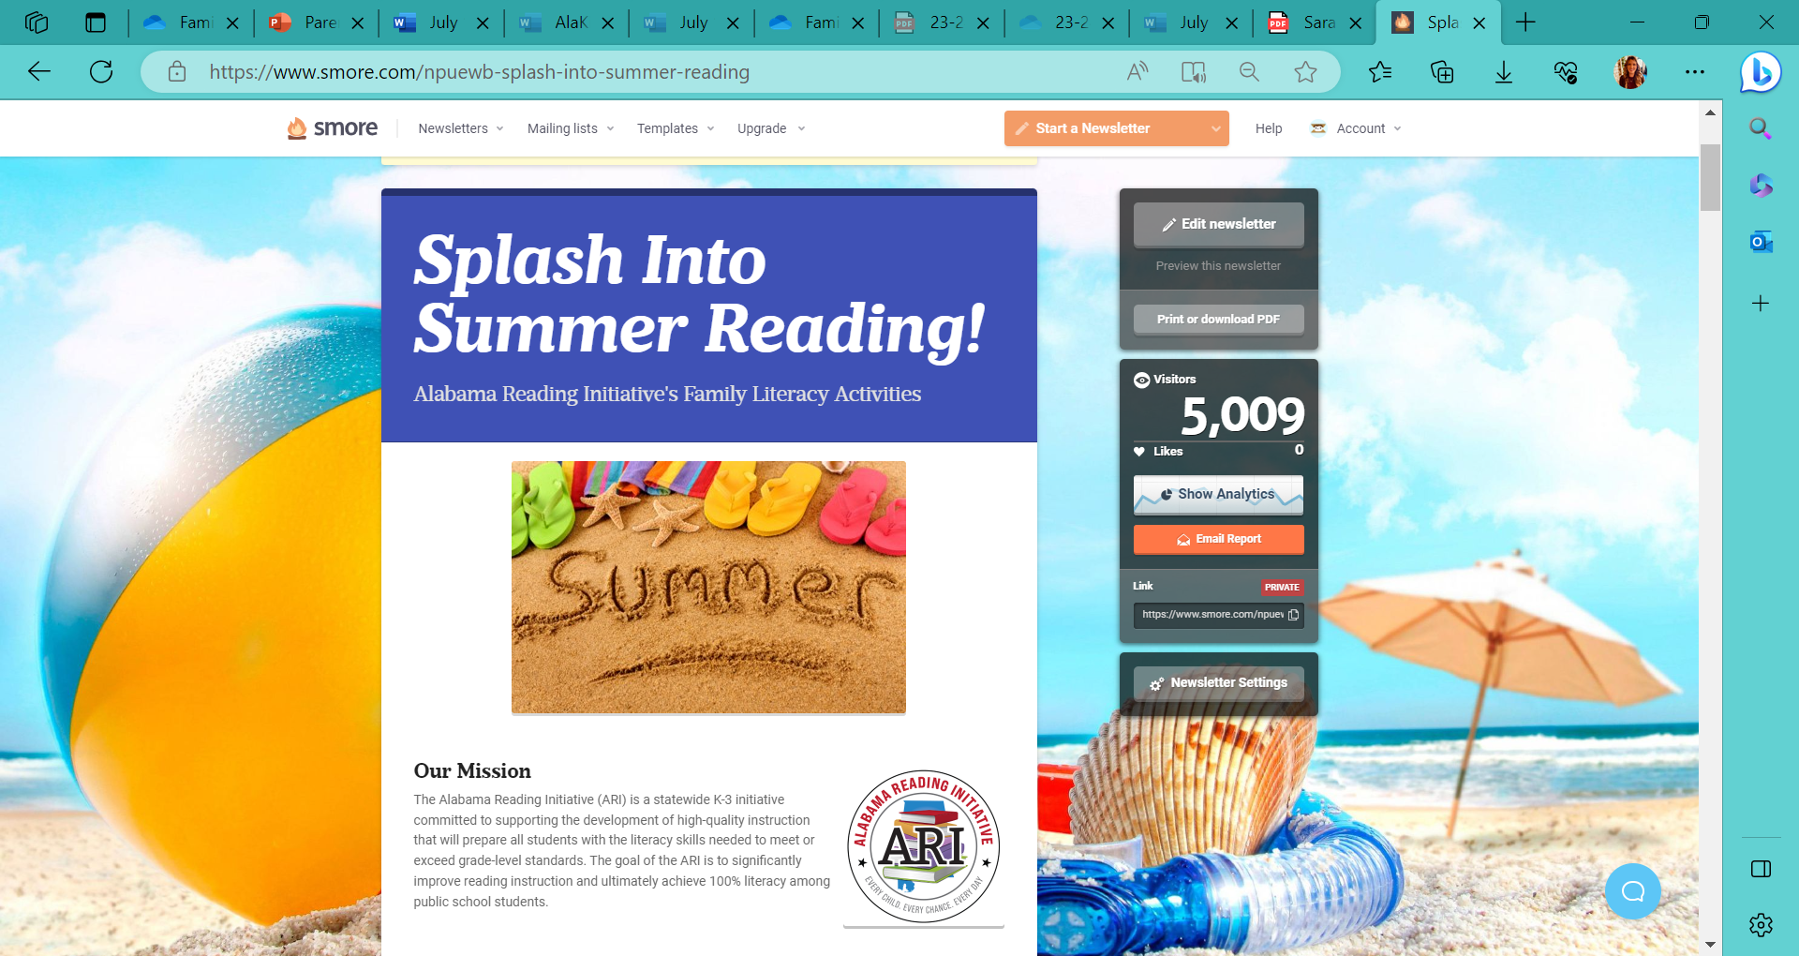
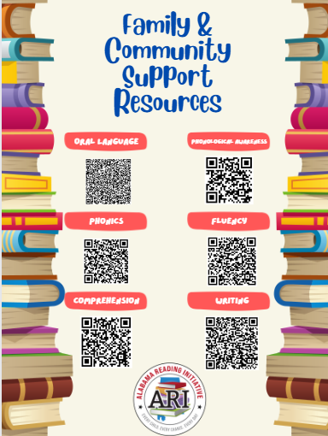
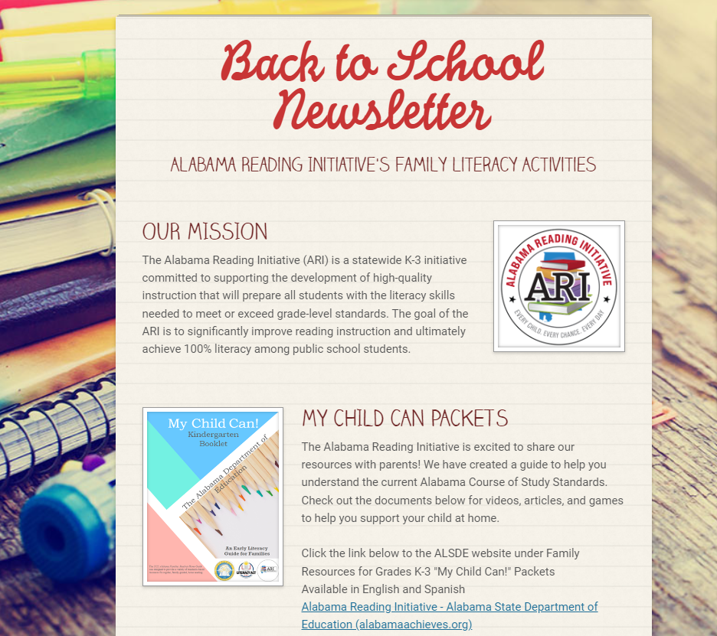
Parent Resources
Notes:
3 minutes
Handout 5 My Child Can Packets Handout 23-24 My Child Can! Booklets
Handout 3 Family & Community Support QR Codes QR Codes Flyers
Did you know that the Alabama Reading Initiative produces several resources to support literacy at home?
Each quarter, a parent newsletter is shared with parents and community members. These newsletters include excellent activities to keep you child engaged in literacy activities at home. Videos are also included to assist parents with the activities.
Also, the Alabama Reading Initiative has created “My Child Can” packets for each grade level, kindergarten-3rd grade. Furthermore, additional resources are available for oral reading, phonological awareness, phonics, fluency, comprehension, and writing. These resources are aligned with the standards being taught in each grade level. We have included two handouts to access these materials.

Slide 19
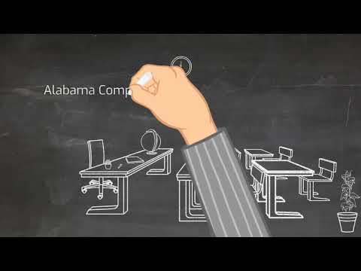
Literacy Act Review
Notes:
4 min.
Show Video:
The Alabama Literacy Act (updated 8.15.23) - YouTube

Slide 20
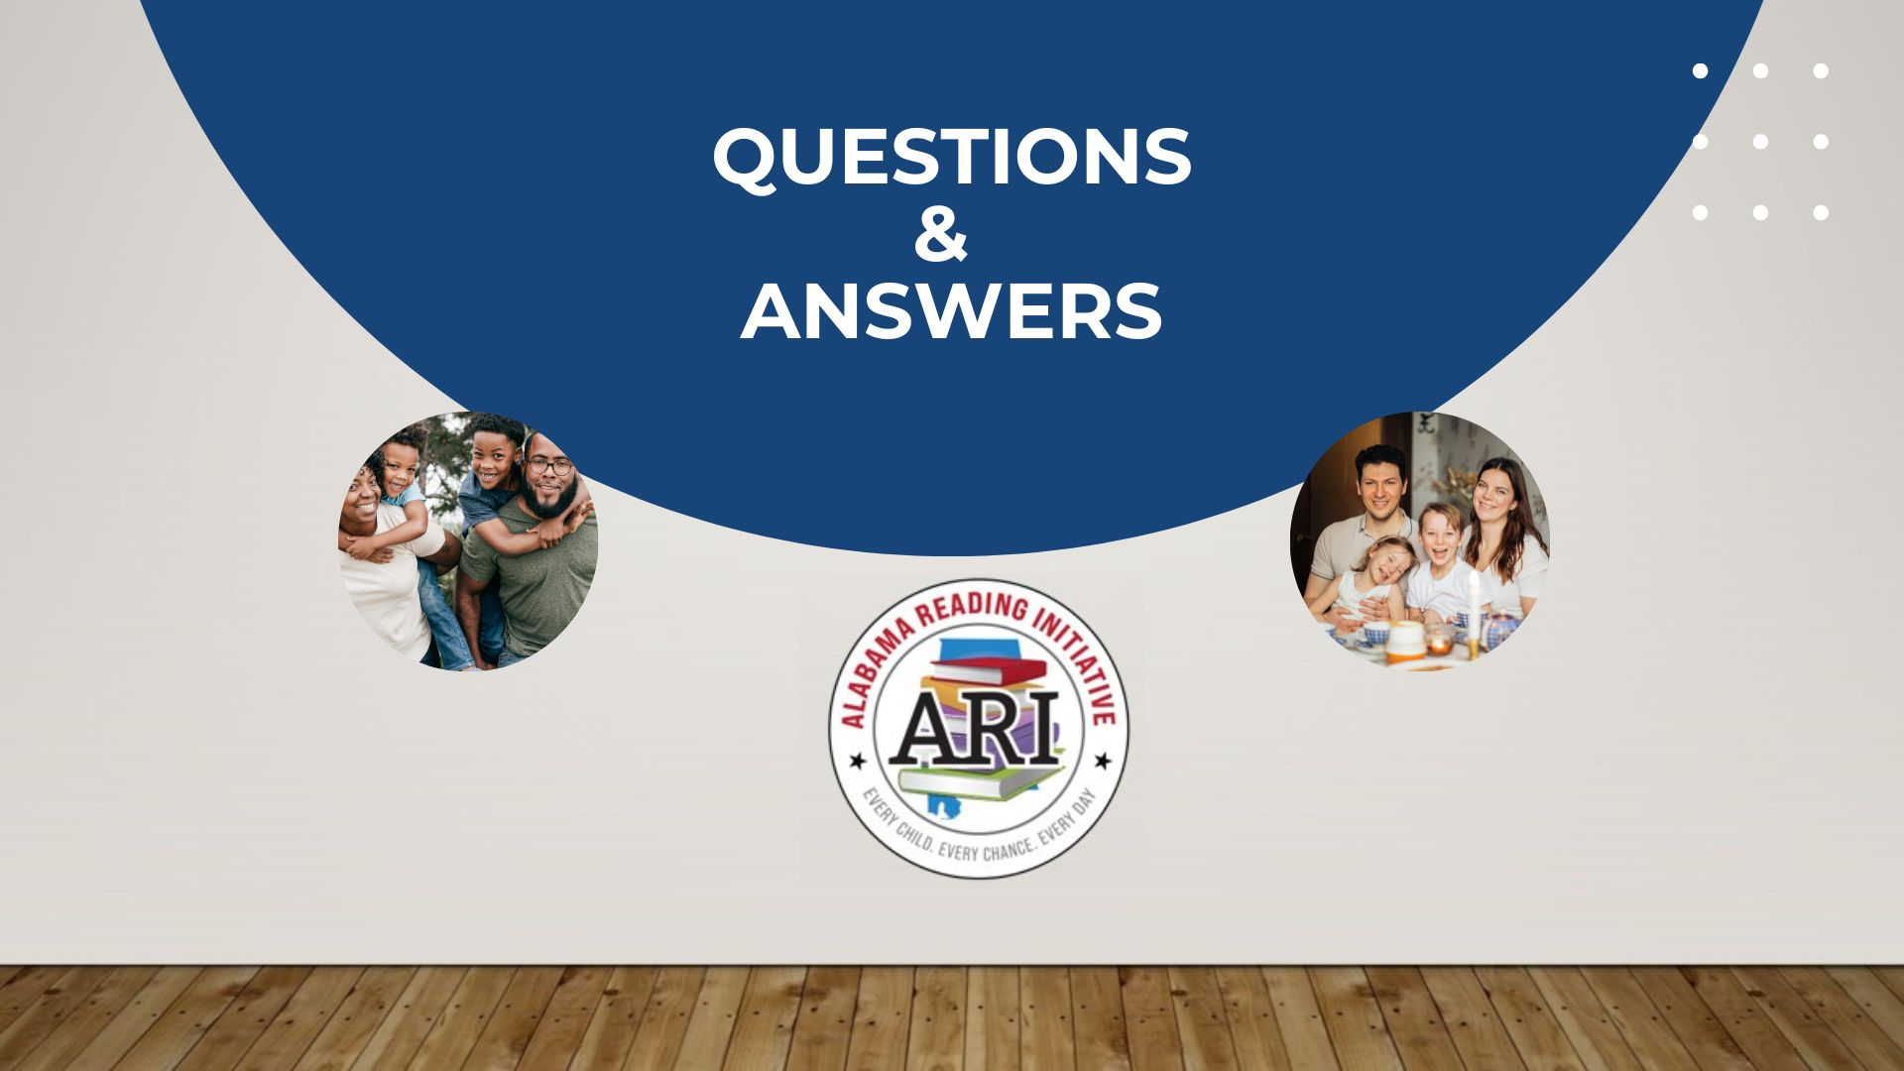

Slide 21
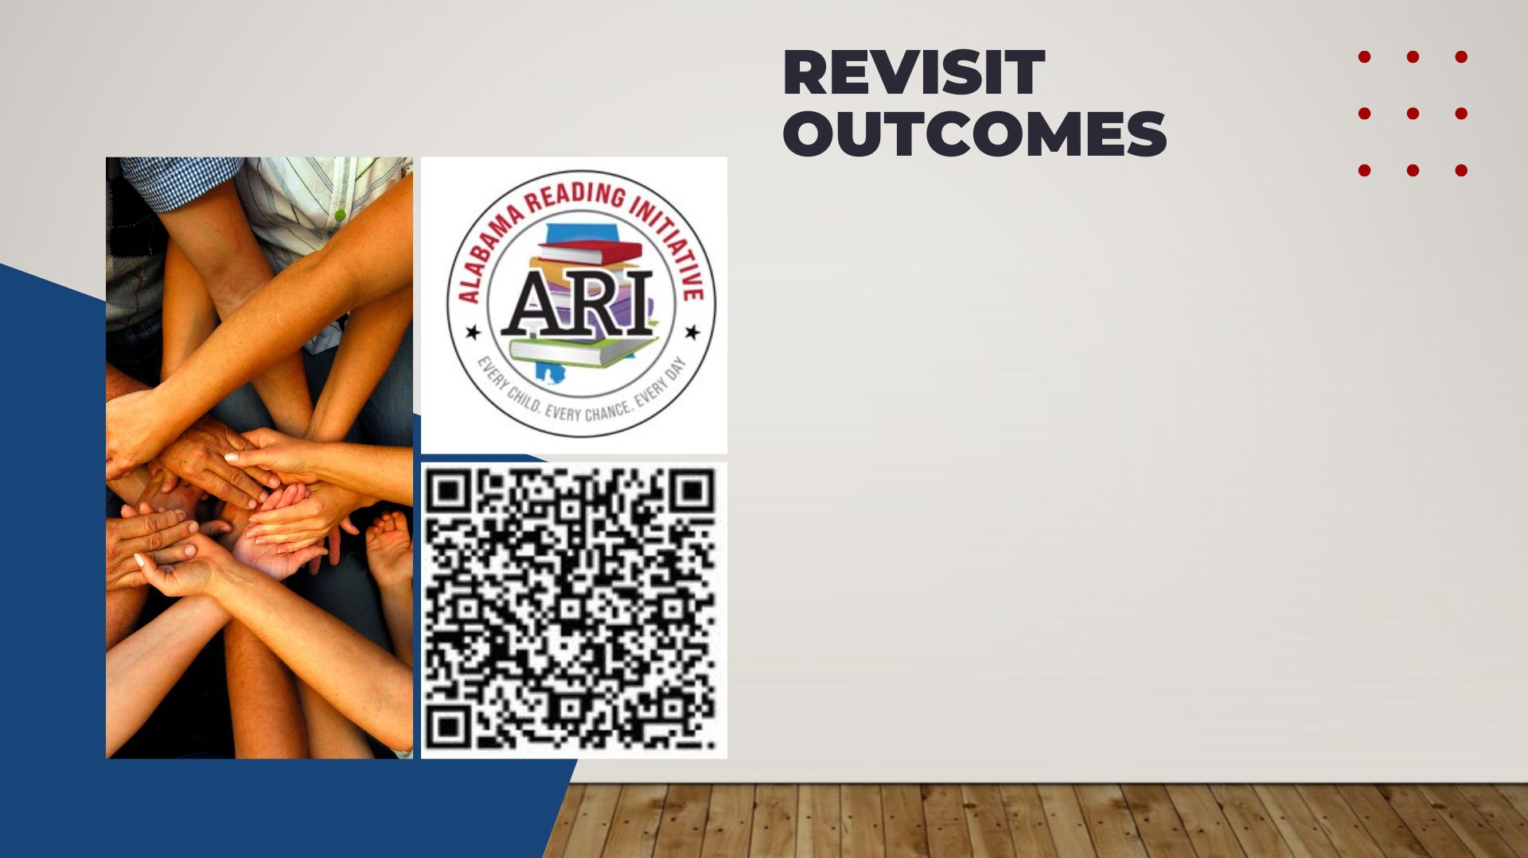
Participants will:​
Develop an initial understanding of the Alabama Literacy Act and its impact on classroom instruction and students’ growth/achievement.​
Set goals for at-home literacy support.
Notes:
4 min.
Handout 1 & 2
Have participants sign in with the QR Code on the slide but also use Handout 2 sign in sheet just in case there are technical difficulties.
New Sign-in link
https://forms.office.com/r/6AGFs0CjmU
Be sure to provide support with completing the sign-in. Families will be asked to identify their region. We want to be sure this information is accurate.
Have participants read the outcomes.
Say: I hope that today you leave with:
an initial understanding of the ALA,
ways to support your students’ growth and achievement,
Activities you can use at home to promote literacy.

Slide 22
THANK YOU FOR YOUR KIND ATTENTION!
THE ALABAMA READING INITIATIVE IS YOUR PARTNER IN EDUCATION!
Notes:
If there are questions you are unsure of, explain that you will reach out to your regional for more clarification and get back to them with an answer.

